Slide 1
Association for the Development of the Kolbuszowa Poviat NIL

Slide 2
Association activities
As part of its statutory activities, the Association runs: the Social Integration Center with a poviat range for 15 people, the Continuing Education Center, the Entrepreneurship Incubator, the NGO Incubator, the Social Economy Support Center and the Free Legal Aid Point. It is a local organization intermediating in food aid for 1,250 people, a signatory of the Kolbuszowa Agreement for Employment and the initiator of the Social Agreement for social exclusion and reduction of unemployment in the poviat through the development of the social economy.

Slide 3
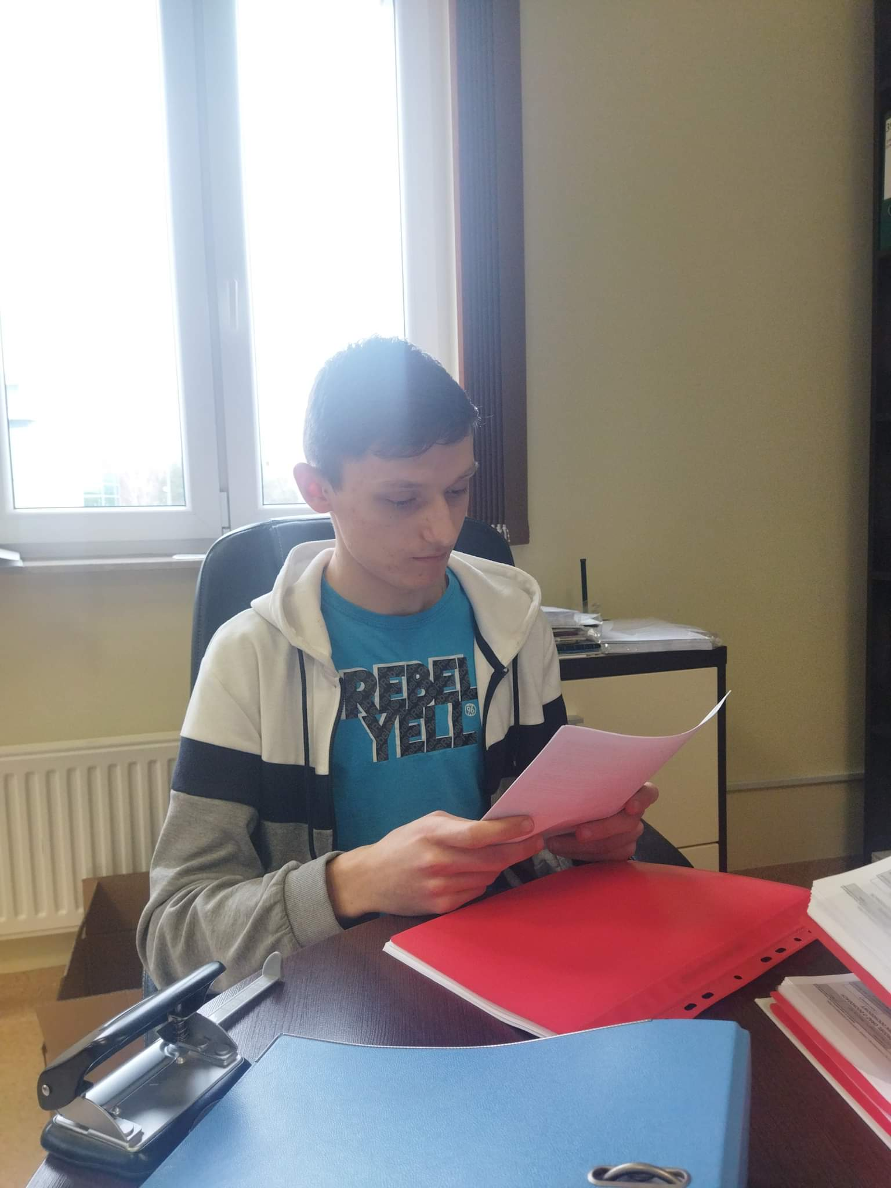
Internship
During the internship, I mainly dealt with the sorting of VAT invoices for the purchase according to the order from the oldest to the youngest, and then putting them into binders.

Slide 4
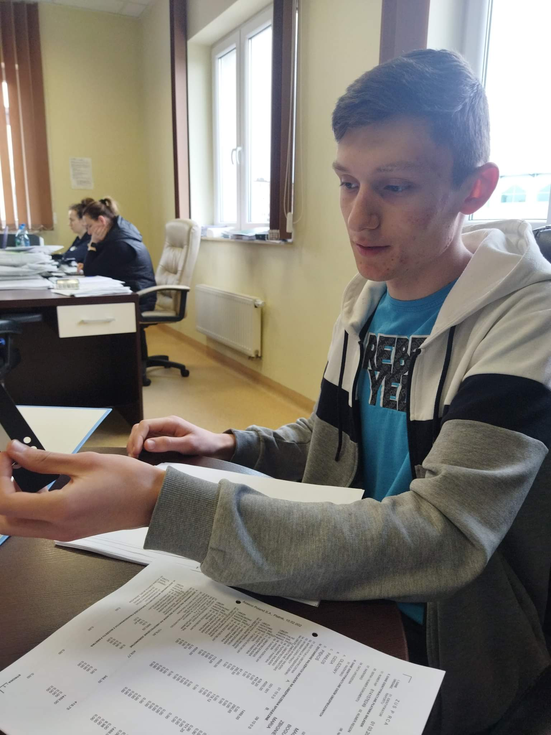
Internship cont.
I was also involved in inserting PIT-11 declarations and insurance documents into documents sleeves and binders.

Slide 5
Presentation made by:
Szymon Zieliński

